Slide 1


CS 235: User Interface Design May 12 Class Meeting
Department of Computer Science San Jose State University Spring 2015 Instructor: Ron Mak
www.cs.sjsu.edu/~mak

Slide 2
Final Project Presentations
Thursday, May 21
12:15 – 2:30 PM
Each team has 25 minutes to present and for questions and answers.

Slide 3
Final Project Report: Due Friday, May 22
What is the purpose of your application?
Who will use it and what are their goals?
How did you fulfill the goals?
What are your data sources?
What do your visualizations show?
How did you create the visualizations?
Screen shots.
How to run your application?

Slide 4
Postmortem Reports
Due Friday, May 22
A few paragraphs.
Word document or just an email message
Individual and private.
What did you learn in this class?
What were your accomplishments on your project team?
How well did each of your teammates do?

Slide 5
Dashboard Design Practices
Organize information to support its meaning and use.
Maintain consistency to enable quick and accurate interpretation.
Put supplementary information within reach.
Make the experience aesthetically pleasing.
Expose lower-level conditions.
Prevent excessive alerts.
Keep viewers in the loop.
Accommodate real-time monitoring.

Slide 6
Organize Information
Organize groups according to activities, entities, and use.
Co-locate items that belong to the same group.
Delineate groups using the least-visible means.
Support meaningful comparisons.
Discourage meaningless comparisons.

Slide 7
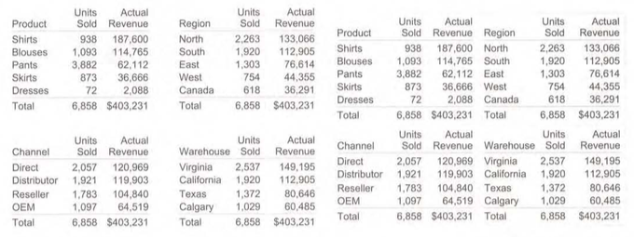
Delineate groups
Examples:
Left four tables: white space alone
Right four tables: light gray borders

Slide 8
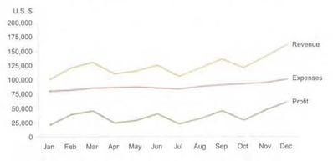
Support Meaningful Comparisons
Display different measures in the same graph:

Slide 9
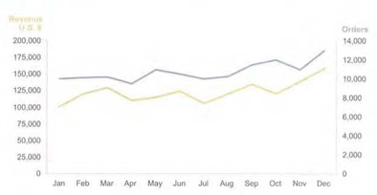
Support Meaningful Comparisons, cont’d
Two quantitative scales:

Slide 10
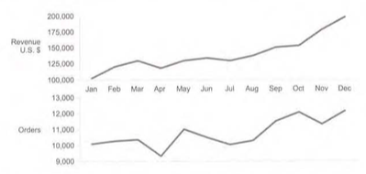
Support Meaningful Comparisons, cont’d
One graph above another with a shared axis:

Slide 11
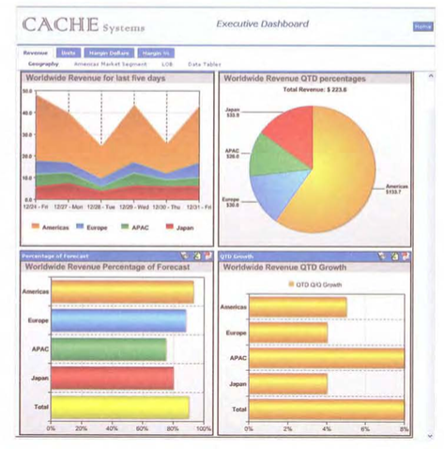
Discourage Meaningless Comparisons
Example: Inconsistent use of color inadvertently encourages meaningless comparisons.

Slide 12
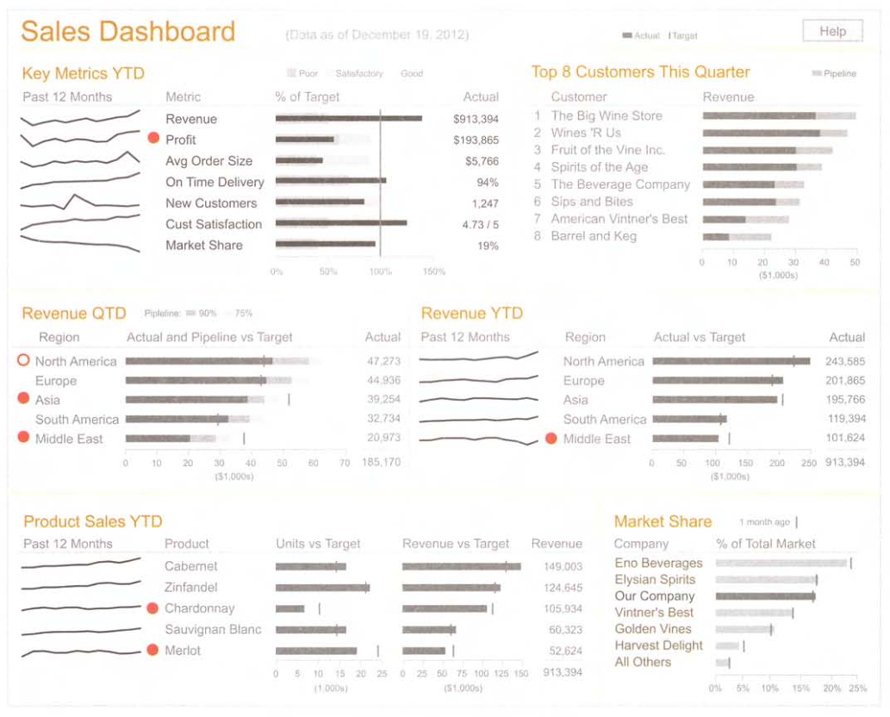
Expose Lower-Level Conditions
Highlight low level detail items that need viewer attention.

Slide 13
Bullet Graphs
A bullet graph shows three items at a glance:
a primary measure
a target value
qualitative ranges of performance (poor, good, etc.)
target value
range 1
range 2
range 3
range 4
primary measure
0
10
20
30
40
50
60
70
80
90
100
Information Dashboard Design, 2nd ed.
by Stephen Few
Analytics Press, 2013

Slide 14
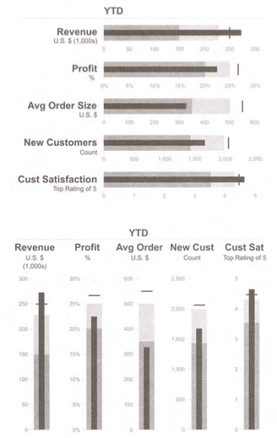
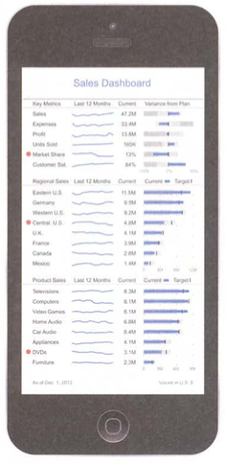
Bullet Graphs are Space Efficient

Slide 15
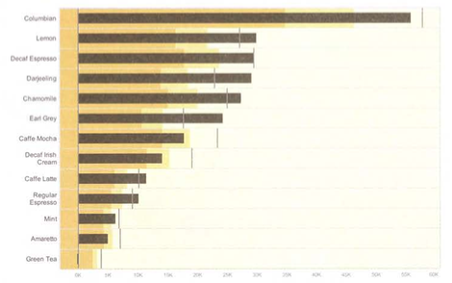
Multiple Bullet Graphs in a Series
Information Dashboard Design, 2nd ed.
by Stephen Few
Analytics Press, 2013

Slide 16



Bullet Graphs: Alternatives to Bars
Information Dashboard Design, 2nd ed.
by Stephen Few
Analytics Press, 2013

Slide 17


Sparklines
Like bullet graphs, sparklines are compact ways of displaying information.
More informative than a simple trend arrow:
A sparkline also shows the history of a value:

Slide 18
Sparklines: Compact Display
Information Dashboard Design, 2nd ed.
by Stephen Few
Analytics Press, 2013

Slide 19
Sparklines: Enhanced
The acceptable range is the gray background:
The fainter line is the prior period:
The gray area is excessive expenses.

Slide 20

Sparklines: Scaling
We do not show a sparkline’s quantitative scale.
Scale a sparkline to fill the entire plot area in order to show the pattern of change:

Slide 21
Sparklines: What to Display
Use sparklines to display patterns and trends of change over time.
Also show:
Magnitudes of values
Magnitudes of change
Rates of change
Degree of variability

Slide 22
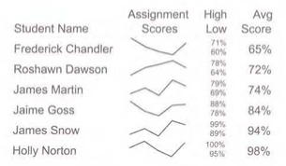
Sparklines: Fill the Plot area
Fill the vertical space of the plot area of each individual sparkline.
Begin with the lowest value at the bottom.
End with the highest value at the top.

Slide 23
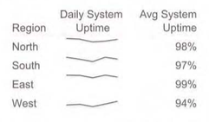
Sparklines: Useful Quantitative Range
Display a consistent quantitative range that is useful for interpreting the values.
90-100%

Slide 24
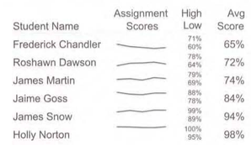
Sparklines: Consistent Scale
Maintain a consistent scale among a series of sparklines.
Begin with the lowest value of the entire series.
End with the highest value of the entire series.

Slide 25
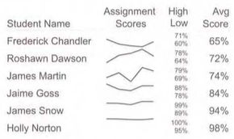
Sparklines: Subrange of Values
Display a series of sparklines in relation to a particular subrange of values.
For example: 1 standard deviation from the mean.
Scale each sparkline individually from its lowest to highest value.

Slide 26
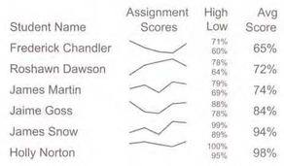
Sparklines: Consistent Spread
Maintain a consistent spread among a series of sparklines.
Use the largest spread of the series.

Slide 27
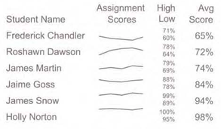
Sparklines: Logarithmic Scale
Display sparklines logarithmically rather then linearly.
Display rates of change.
Display degrees of variability.

Slide 28
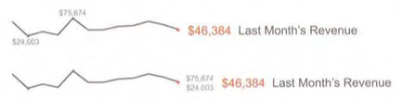
Sparklines: Magnitude of Change
Convey the magnitude of change by labeling the highest and lowest values.

Slide 29
Sparklines: Bandlines
Use bandlines to show the first quartile, the midspread, and the fourth quartile.
Show all four quartiles and the median.
Quartile 4
Midspread (quartiles 2 and 3)
Quartile 1
Quartile 4
Quartile 3
Quartile 2
Quartile 1

Slide 30
Sparklines: Outliers
Mark outlier values on the sparkline.
Black dot: low end
White dot: high end

Slide 31
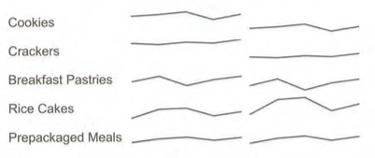
Sparklines: Degrees of Change
Example: The sparklines on the left below show actual values, and the sparklines on the right show degrees of change.

Slide 32
How to Display a Data Value
Consider a single simple display:
We can add more information:
We need to pay attention to this value!
Show the reason to pay attention: the target.
YTD Expenses $487,321
YTD Expenses $487,321
 | Actual | Target
YTD Expenses | $487,321 | $450,000

Slide 33
How to Display a Data Value, cont’d
Show more information: the variance.
 | Actual | Target | Variance
YTD Expenses | $487,321 | $450,000 | +$37,321
 | Actual | Target | Variance %
YTD Expenses | $487,321 | $450,000 | +8%

Slide 34
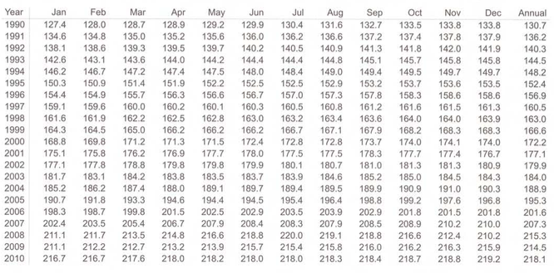
Table vs. Graph
Tables are good for looking up information:
Information Dashboard Design, 2nd ed.
by Stephen Few
Analytics Press, 2013

Slide 35
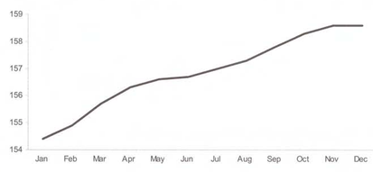
Table vs. Graph, cont’d
Graphs are good for revealing the shape of the data:
Information Dashboard Design, 2nd ed.
by Stephen Few
Analytics Press, 2013

Slide 36
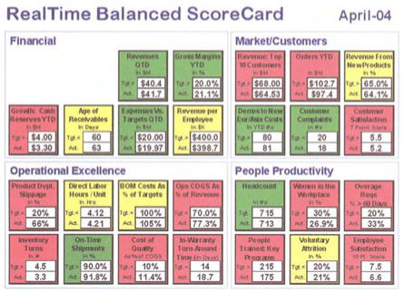
Table Format
Beware the fancy table format that obscures information!
Information Dashboard Design, 2nd ed.
by Stephen Few
Analytics Press, 2013

Slide 37
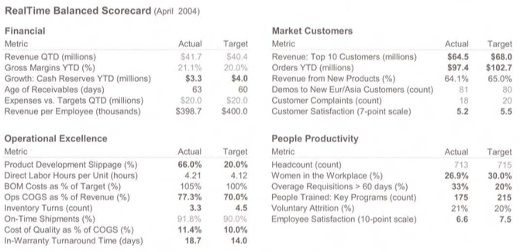
Table Format, cont’d
A simpler format can be easier to read:
Information Dashboard Design, 2nd ed.
by Stephen Few
Analytics Press, 2013

Slide 38
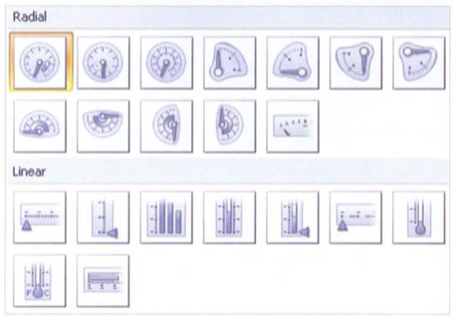
Fancy Gauges and Meters
Beware of fancy gauges and meters provided by dashboard creation tools.
Examples of poor quality gauges
from Microsoft Visual Studio
that are hard to read.
Information Dashboard Design, 2nd ed.
by Stephen Few
Analytics Press, 2013

Slide 39
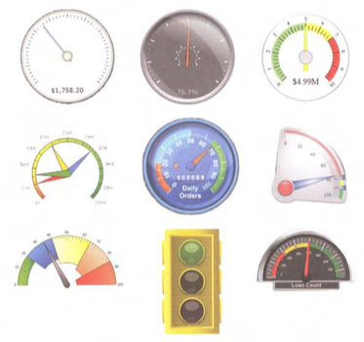
Fancy Gauges and Meters, cont’d
More fancy dashboard gauges to avoid.
Information Dashboard Design, 2nd ed.
by Stephen Few
Analytics Press, 2013

